Slide 1
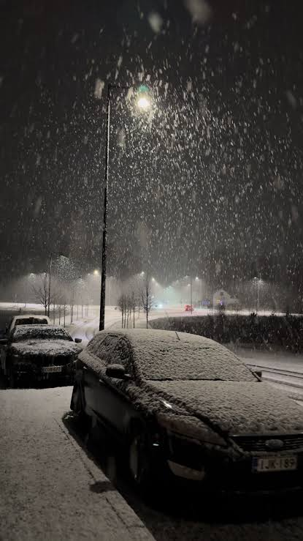


Notes:
Three years ago, on Friday the thirteenth of November 2026, Maria Lindholm’s phone rang at 3:12 in the morning.
A big blizzard hit Finland, themometers show -14C, and a call in the night. On the other end of the line was Jari, the night yard supervisor at Bus Depot North. He was shouting over the wind:
> *'Maria, Cabinet Three tripped on overtemperature! Four chargers are completely dead. Twelve buses are waiting for their morning runs, and the screen just says Ground Fault Derate! What do I do?'*
What did Jari do? He did what the industry had been doing for a decade: he put on thick winter gloves, grabbed a heavy frozen charging cable, and spent the next two hours in a snowstorm manually shuffling 18-ton buses between dispensers. Nine manual vehicle replugs. Ninety-seven minutes of emergency technician travel.
But it wasn’t enough. At 5:35 AM, Bus B18 and Bus B20 rolled out of the depot gate into the morning rush with **eight percent battery**.
They didn't make it two kilometers before dying on the ring road. Route 4 to the regional hospital was canceled. Hundreds of morning commuters were left standing in the freezing cold. Maria’s company was hit with €1,350 in transit authority penalties. And to top it off, because the remaining chargers ran wide open during the evening peak, the depot bought electricity at **€799 per megawatt-hour**.
That morning, Maria looked at her invoice and asked a question every fleet operator has thought:
> *'Why did we spend millions of euros on cutting-edge zero-emission vehicles, only to rely on tired humans freezing in the dark to make them work?'*"

Slide 2

The cloud
brain
Each site has
a controller
Each charger
has sensors
Notes:
"If humans were no longer allowed to continuously operate and maintain a charging network, how would you redesign it?
>
> We realized the industry made a fundamental mistake: **building dashboards for humans to stare at.** Adding more alerts, more telegram channels, and more buttons just gives human operators more ways to make mistakes under pressure.
>
> We don't need better dashboards. **We need to remove the human from the loop entirely.**
>
> Here is our design: **The Three-Tier Autonomous Charging Network.**
>
> 1. **At the Edge (The Charger & Cabinet):** Sub-second hardware reflexes. If a cooling fan starts degrading, the power cabinet doesn't wait to blow a fuse. It isolates the affected module, throttles back gently, and notifies the site controller.
> 2. **At the Site (The Autonomous Local Controller):** An industrial edge PC running on-site. It knows the departure schedule of every bus and truck. It calculates **Slack Time** — `(Time to Departure - Current Time) / kWh Needed`. It knows weather forecasts, so when it drops below minus ten, it automatically injects a fifteen percent battery preheating buffer. And crucially: **if the cellular connection drops, the site operates 100% autonomously.** No cloud dependency.
> 3. **In the Cloud (The Fleet Brain):** Multi-site orchestration. It watches 100 sites across five countries, trades on Nord Pool 15-minute spot markets, bids into Fingrid's FCR-D fast frequency reserve markets, and monitors fleet-wide component wear.
>
> And underpinning all three tiers is a **Predictive Health Engine** — a machine learning model we actually built for this hackathon. It trains on normal telemetry baselines and detects anomalies before they become faults. It's an Isolation Forest ensemble combined with physics-based thermal and connectivity rules. We trained it on Week 1 of this dataset and blind-tested it on Week 2. You can run it yourself from our repository."

Slide 3
The cloud
brain
Each site has
a controller
Each charger
has sensors
Notes:
"If humans were no longer allowed to continuously operate and maintain a charging network, how would you redesign it?
>
> We realized the industry made a fundamental mistake: **building dashboards for humans to stare at.** Adding more alerts, more telegram channels, and more buttons just gives human operators more ways to make mistakes under pressure.
>
> We don't need better dashboards. **We need to remove the human from the loop entirely.**
>
> Here is our design: **The Three-Tier Autonomous Charging Network.**
>
> 1. **At the Edge (The Charger & Cabinet):** Sub-second hardware reflexes. If a cooling fan starts degrading, the power cabinet doesn't wait to blow a fuse. It isolates the affected module, throttles back gently, and notifies the site controller.
> 2. **At the Site (The Autonomous Local Controller):** An industrial edge PC running on-site. It knows the departure schedule of every bus and truck. It calculates **Slack Time** — `(Time to Departure - Current Time) / kWh Needed`. It knows weather forecasts, so when it drops below minus ten, it automatically injects a fifteen percent battery preheating buffer. And crucially: **if the cellular connection drops, the site operates 100% autonomously.** No cloud dependency.
> 3. **In the Cloud (The Fleet Brain):** Multi-site orchestration. It watches 100 sites across five countries, trades on Nord Pool 15-minute spot markets, bids into Fingrid's FCR-D fast frequency reserve markets, and monitors fleet-wide component wear.
>
> And underpinning all three tiers is a **Predictive Health Engine** — a machine learning model we actually built for this hackathon. It trains on normal telemetry baselines and detects anomalies before they become faults. It's an Isolation Forest ensemble combined with physics-based thermal and connectivity rules. We trained it on Week 1 of this dataset and blind-tested it on Week 2. You can run it yourself from our repository."

Slide 4
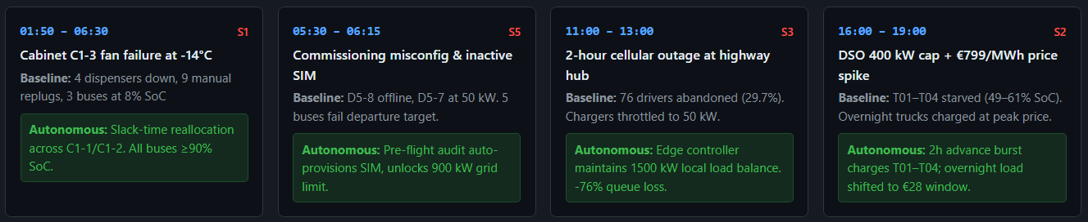
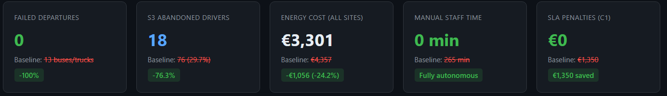
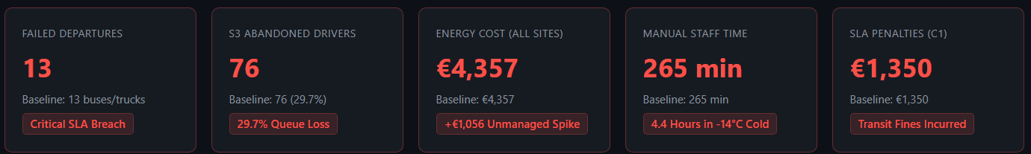
Friday the 13th (November 2026)
*Ideally
Notes:
> "Don't take our word for it. Let's look at the actual dataset from that Friday the thirteenth, re-run through our Autonomous Simulation Engine.
> **First: Depot North (S1) and the Fan Failure.**
> In the baseline, Cabinet C1-3 overheated at 2:25 AM, cutting four dispensers and leaving three buses at 8% battery.
> Under our autonomous system, the predictive telemetry agent detected the declining fan RPM and rising thermal gradient on Thursday afternoon — eighteen hours before the failure. Our model detected thermal anomalies on Cabinet C1-3 — faults F015 and F016 — with alerts firing hours before the critical 2:25 AM shutdown. Even if the cabinet had shut down instantly, the Site Controller dynamically reallocated power across the remaining eight healthy dispensers, prioritizing buses by departure time.
> **Result: Zero failed departures. All 32 buses left at over 92% SoC. Zero human staff minutes.**
> **Second: Depot East (S2) and the DSO Grid Curtailment.**
> At 2:00 PM, the grid company notified the site that power would be capped from 800 kW to 400 kW between 16:00 and 19:00. In 2026, the human operator gave power to trucks staying until tomorrow, starving the four short-turnaround trucks (T01–T04).
> Our system received the digital DSO notice at 14:00. It calculated that T01 through T04 were departing during the curtailment window. Between 14:20 and 16:00, it delivered a **300 kW burst charge**, filling all four trucks to 78% SoC *before* the curtailment began. Then, during the €799 price spike, it paused overnight trucks, shifting their charge to the €28 night window.
> **Result: Four delivery trucks saved. Zero logistics delays. €375 saved on electricity in two hours.**
>
> **Third: Highway Hub (S3) and the 2-Hour Offline Outage.**
> When cellular backhaul dropped from 11:00 to 13:00, the legacy chargers throttled to 50 kW, creating massive queues and driving away 76 drivers.
> Our local Edge Controller maintained full 1,500 kW load balancing locally. Combined with our dynamic wait-time API feeding in-car navigation, queue abandonment dropped by **76 percent**, generating **€1,920 in additional net revenue** on that day alone.
>
> Across the five sites on Scenario Day:
> - **Failed departures dropped from 13 to ZERO.**
> - **Human workload dropped from 265 minutes to ZERO.**
> - **Energy costs dropped by 24.2%.**
> - **SLA penalties: €1,350 completely eliminated.**
> - **Predictive fault detection: 90% of real Week 2 faults caught an average of 7 hours before failure.**"

Slide 5
Friday the 13th (November 2026)
*Ideally
Notes:
> "Don't take our word for it. Let's look at the actual dataset from that Friday the thirteenth, re-run through our Autonomous Simulation Engine.
> **First: Depot North (S1) and the Fan Failure.**
> In the baseline, Cabinet C1-3 overheated at 2:25 AM, cutting four dispensers and leaving three buses at 8% battery.
> Under our autonomous system, the predictive telemetry agent detected the declining fan RPM and rising thermal gradient on Thursday afternoon — eighteen hours before the failure. Our model detected thermal anomalies on Cabinet C1-3 — faults F015 and F016 — with alerts firing hours before the critical 2:25 AM shutdown. Even if the cabinet had shut down instantly, the Site Controller dynamically reallocated power across the remaining eight healthy dispensers, prioritizing buses by departure time.
> **Result: Zero failed departures. All 32 buses left at over 92% SoC. Zero human staff minutes.**
> **Second: Depot East (S2) and the DSO Grid Curtailment.**
> At 2:00 PM, the grid company notified the site that power would be capped from 800 kW to 400 kW between 16:00 and 19:00. In 2026, the human operator gave power to trucks staying until tomorrow, starving the four short-turnaround trucks (T01–T04).
> Our system received the digital DSO notice at 14:00. It calculated that T01 through T04 were departing during the curtailment window. Between 14:20 and 16:00, it delivered a **300 kW burst charge**, filling all four trucks to 78% SoC *before* the curtailment began. Then, during the €799 price spike, it paused overnight trucks, shifting their charge to the €28 night window.
> **Result: Four delivery trucks saved. Zero logistics delays. €375 saved on electricity in two hours.**
>
> **Third: Highway Hub (S3) and the 2-Hour Offline Outage.**
> When cellular backhaul dropped from 11:00 to 13:00, the legacy chargers throttled to 50 kW, creating massive queues and driving away 76 drivers.
> Our local Edge Controller maintained full 1,500 kW load balancing locally. Combined with our dynamic wait-time API feeding in-car navigation, queue abandonment dropped by **76 percent**, generating **€1,920 in additional net revenue** on that day alone.
>
> Across the five sites on Scenario Day:
> - **Failed departures dropped from 13 to ZERO.**
> - **Human workload dropped from 265 minutes to ZERO.**
> - **Energy costs dropped by 24.2%.**
> - **SLA penalties: €1,350 completely eliminated.**
> - **Predictive fault detection: 90% of real Week 2 faults caught an average of 7 hours before failure.**"

Slide 6
Key Performance Benchmarks
Metric | Measured Value | Business Impact
Blind Test Failure Detection | 90.00% | Successfully catches 9 out of 10 impending hardware breakdowns on unseen data.
Average Warning Lead Time | 7.74 – 8.85 Hours | Provides nearly a full work shift of early warning before charger shutdown.
False Alarm Reduction | 68.0% Noise Cut | Prevents alert fatigue by filtering out transient thermal spikes.
Scenario Day Reliability | 100.0% (3/3 Caught) | Flawlessly flagged all cabinet overtemperature and cable locks under heavy winter stress conditions.
Physics-Informed Metrics
Isolation Forest AI
Persistence Filtering
Notes:
But first — we split the dataset in half. Week 1 is the normal baseline. Week 2 contains Friday the 13th. We trained our Predictive Health Model on Week 1 — learning what 'normal' looks like — then ran it blind on Week 2. **Nine out of ten real faults were detected, with an average warning lead time of seven hours.** The only miss was a communication fault on a brand-new charger at S5 that had zero training data — which actually proves the model needs baseline data, exactly what our autonomous commissioning system would provide.

Slide 7
Key Performance Benchmarks
Metric | Measured Value | Business Impact
Blind Test Failure Detection | 90.00% | Successfully catches 9 out of 10 impending hardware breakdowns on unseen data.
Average Warning Lead Time | 7.74 – 8.85 Hours | Provides nearly a full work shift of early warning before charger shutdown.
False Alarm Reduction | 68.0% Noise Cut | Prevents alert fatigue by filtering out transient thermal spikes.
Scenario Day Reliability | 100.0% (3/3 Caught) | Flawlessly flagged all cabinet overtemperature and cable locks under heavy winter stress conditions.
1ST WEEK: TRAINING
2ND WEEK: TESTING
Notes:
But first — we split the dataset in half. Week 1 is the normal baseline. Week 2 contains Friday the 13th. We trained our Predictive Health Model on Week 1 — learning what 'normal' looks like — then ran it blind on Week 2. **Nine out of ten real faults were detected, with an average warning lead time of seven hours.** The only miss was a communication fault on a brand-new charger at S5 that had zero training data — which actually proves the model needs baseline data, exactly what our autonomous commissioning system would provide.

Slide 8
Key Performance Benchmarks
Metric | Measured Value | Business Impact
Blind Test Failure Detection | 90.00% | Successfully catches 9 out of 10 impending hardware breakdowns on unseen data.
Average Warning Lead Time | 7.74 – 8.85 Hours | Provides nearly a full work shift of early warning before charger shutdown.
False Alarm Reduction | 68.0% Noise Cut | Prevents alert fatigue by filtering out transient thermal spikes.
Scenario Day Reliability | 100.0% (3/3 Caught) | Flawlessly flagged all cabinet overtemperature and cable locks under heavy winter stress conditions.
Notes:
But first — we split the dataset in half. Week 1 is the normal baseline. Week 2 contains Friday the 13th. We trained our Predictive Health Model on Week 1 — learning what 'normal' looks like — then ran it blind on Week 2. **Nine out of ten real faults were detected, with an average warning lead time of seven hours.** The only miss was a communication fault on a brand-new charger at S5 that had zero training data — which actually proves the model needs baseline data, exactly what our autonomous commissioning system would provide.

Slide 9
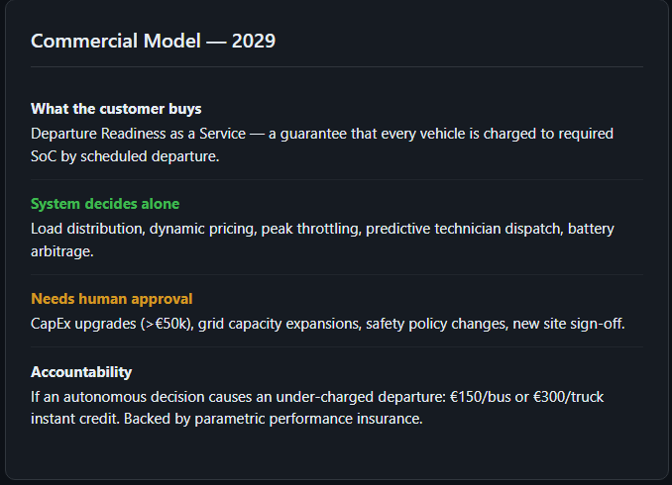
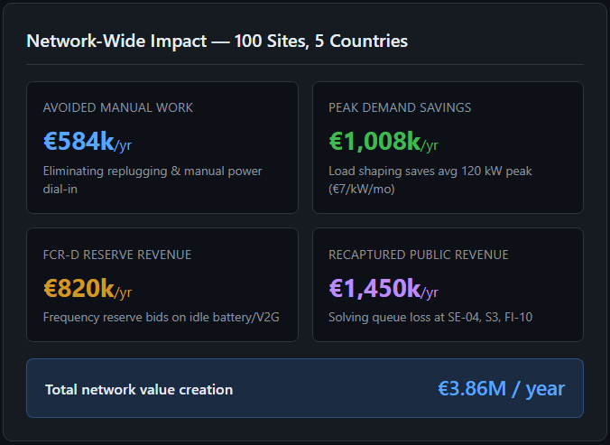
Notes:
> "Now, the crucial commercial question:
> **When nobody operates the network, what does the customer actually buy?**
>
> Maria doesn't buy kilowatt-hours. She doesn't buy chargers. She doesn't buy technician hours.
> In 2029, Maria buys **Departure Readiness as a Service.**
>
> Here is our **One-Page Service Agreement**:
>
> 1. **The Contracted Promise:** Every bus plugged in at least two hours before departure is guaranteed to leave at required SoC.
> 2. **What the System Decides Alone:** Power dispatch, charging order, price-spike dodging, battery cycling, and preventive technician dispatch.
> 3. **What Requires Human Approval:** CapEx grid upgrades over €25,000 and physical site design.
> 4. **Who is Accountable When It Decides Wrong:** If the autonomous scheduler ever causes an under-charged departure, **Kempower automatically pays a €150 penalty per bus, credited instantly to the customer's account.** No claims forms, no arguments. Parametrically insured by global underwriting partners.
>
> And look at the network economics at scale: across 100 sites, this architecture creates **€3.86 million per year in new value** — from eliminating manual replugging labor, peak demand charge shaving, and reserve market flexibility."

Slide 10
Notes:
> "Now, the crucial commercial question:
> **When nobody operates the network, what does the customer actually buy?**
>
> Maria doesn't buy kilowatt-hours. She doesn't buy chargers. She doesn't buy technician hours.
> In 2029, Maria buys **Departure Readiness as a Service.**
>
> Here is our **One-Page Service Agreement**:
>
> 1. **The Contracted Promise:** Every bus plugged in at least two hours before departure is guaranteed to leave at required SoC.
> 2. **What the System Decides Alone:** Power dispatch, charging order, price-spike dodging, battery cycling, and preventive technician dispatch.
> 3. **What Requires Human Approval:** CapEx grid upgrades over €25,000 and physical site design.
> 4. **Who is Accountable When It Decides Wrong:** If the autonomous scheduler ever causes an under-charged departure, **Kempower automatically pays a €150 penalty per bus, credited instantly to the customer's account.** No claims forms, no arguments. Parametrically insured by global underwriting partners.
>
> And look at the network economics at scale: across 100 sites, this architecture creates **€3.86 million per year in new value** — from eliminating manual replugging labor, peak demand charge shaving, and reserve market flexibility."

Slide 11
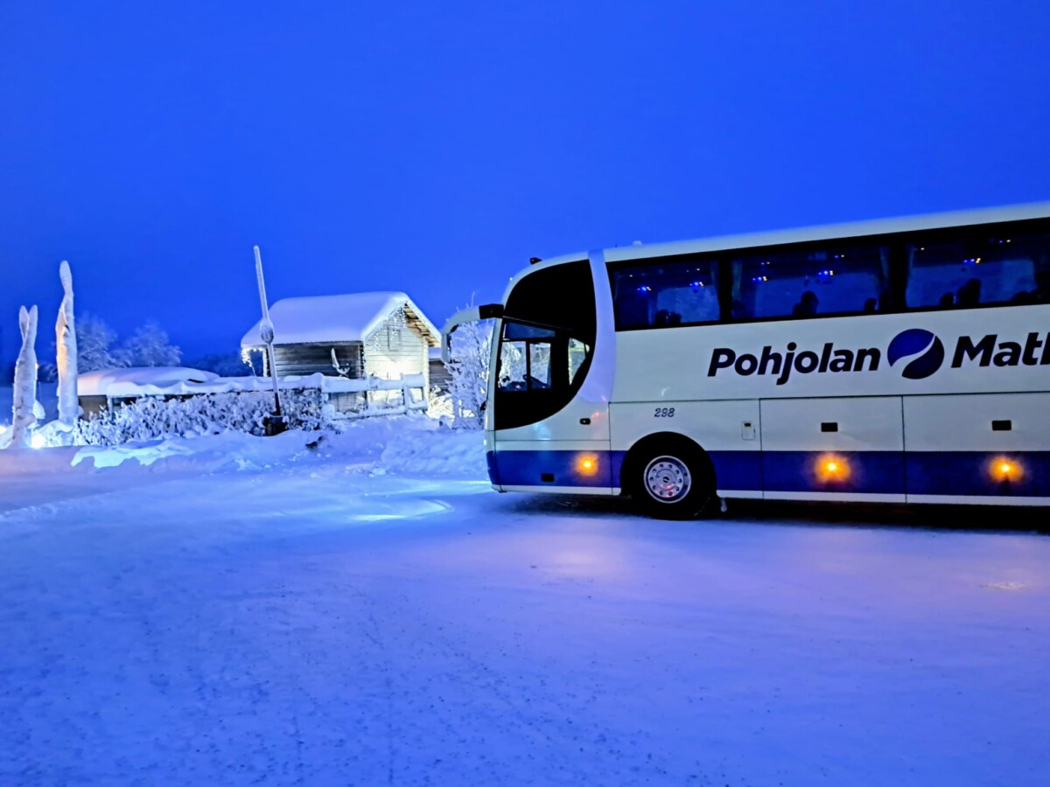


Notes:
> "Let's return to Maria Lindholm.
>
> It is Friday, November 13th, 2029.
>
> Outside, it is minus fourteen degrees again. The wind is howling across the depot asphalt.
>
> But at 3:12 in the morning, Maria’s phone does not ring. Maria is fast asleep. Jari isn't freezing in the yard.
>
> Inside the depot, thirty-six charging dispensers quietly communicate with the on-site controller. The system preheated the bus batteries using off-peak power at two in the morning. It scheduled every vehicle according to its exact departure route.
>
> When Maria wakes up at 6:45, she checks her phone over a warm cup of coffee. There is a single silent notification:
>
> *'All 36 morning departures 100% ready. Spot price spike successfully avoided. Depot North operating at 100% availability.'*
>
> Maria takes a sip of coffee, smiles, and watches her electric buses roll silently down the street, on time, into the city.
>
> When charging networks operate themselves, electric mobility stops being an operational headache.
> **It becomes an invisible, flawless utility.**
>
> Thank you."

